Slide 1


Thinking Technology And Design
Problem Solving Techniques
Dr. Frank Jiang
Email: Frank.Jiang@deakin.edu.au

Slide 2
Abstraction
Solving the problem in a model of the system before applying it to the real system
For Example: Optimising Airflow
Determining streamlines of a vehicle (car, boat, aircraft, etc.) by:
using a model in a wind tunnel
using a mathematical model

Slide 3
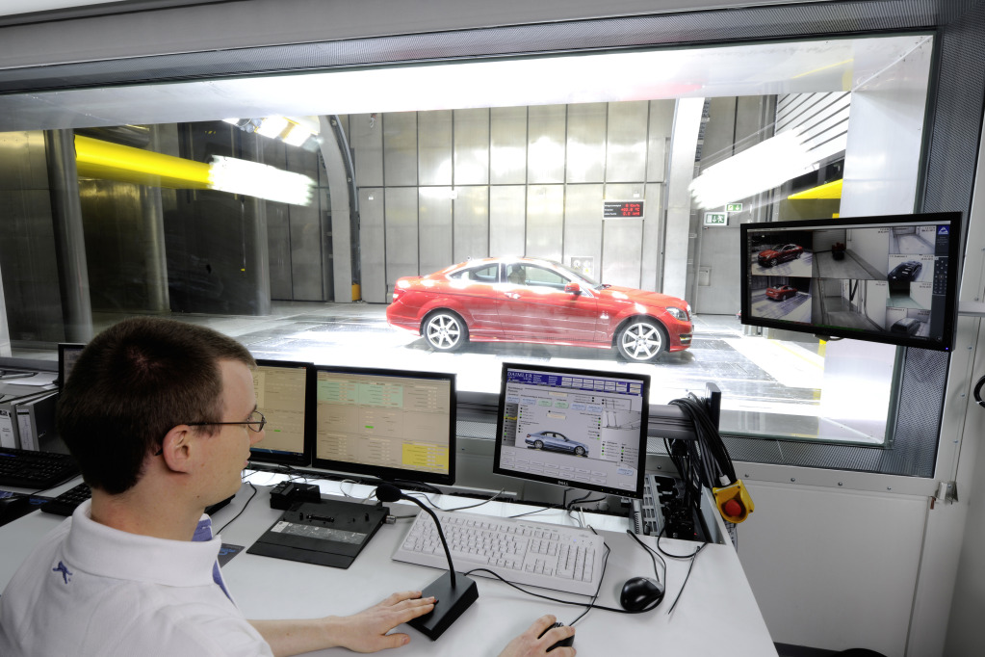
Abstraction in use!

Slide 4

Analogy
Using a solution that solved a similar problem
IT Example:
Creating a web site for company A could be based on an existing web site developed for a similar company B
Code reuse is very important in high level programming languages, especially object oriented (OO) languages

Slide 5

Brainstorming (video)
Especially among groups of people
Obtain many solutions or ideas, combine and develop these until an optimum is found!
Example: Determining the content of this unit
Several IT staff had many meetings to propose and discuss their ideas

Slide 6
Brainstorming – SCAMPER Generating your individual ideas
SCAMPER is based on the notion that everything new is a modification of something that already exists.
Each letter in the acronym represents a different way you can play with the characteristics of what is challenging you to trigger new ideas:
S (Substitute): "Can I replace or change any parts?”
C (Combine): "What can be combined to maximize the number of uses?"
A (Adapt): "Is there something similar to it, but in a different context?"
M (Magnify): "Can I add extra features or somehow add extra value?"
P (Put to Other Uses): "Can I use this idea in other markets or industries?"
E (Eliminate): "What feature can I understate or omit?"
R (Rearrange): "Are there other patterns, layouts or sequences I can use?"
See SCAMPER Primer in Lecture Notes on UTSOnline

Slide 7
Gap Analysis
Review your concept/solution screening matrix. Identify where the reference solution is better than your solution candidate.
Discuss and decide where enhancements are necessary to be competitive – be selective by focusing directly on being competitive.
Pose the question - can your product/solution be more competitive by combining successful concepts/solutions from your candidate product and the reference product/idea?

Slide 8
Refinement
For each item identified in the previous step, brainstorm the enhancements to your concept candidate to make it competitive against the reference product/idea.
Record why these enhancement makes your product/idea more competitive (these are additional Design Goals).

Slide 9
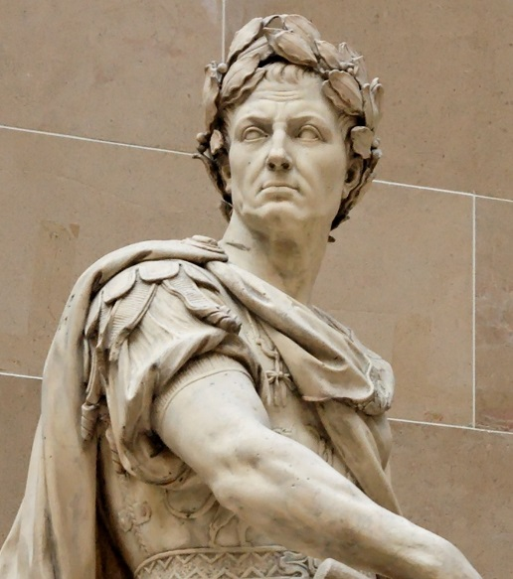
Divide and Conquer (video)
Breaking down a large and complex problem into smaller, solvable and manageable sub-problems.
Combine the solutions of all sub-problems to form one solution to the original problem.
Julius Caesar used a divide and conquer strategy to subdue the Celtic tribes!

Slide 10
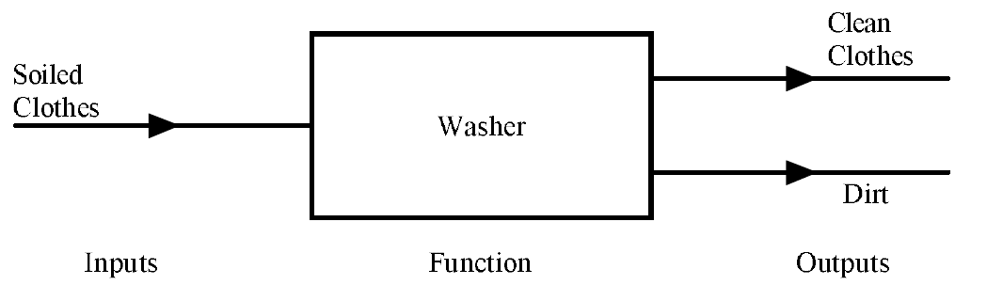
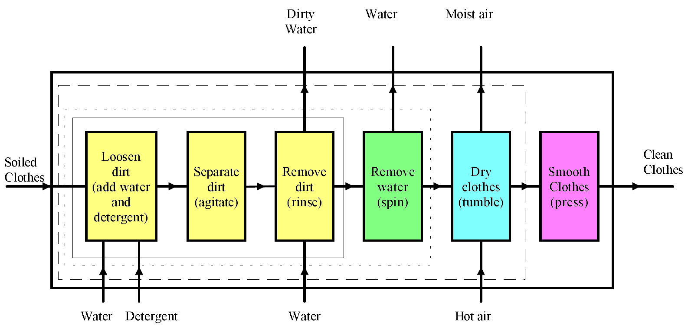
Function Structure
Automatic Washing Machine
Notes:
Design in the Functional Domain is a design methodology in which the design elements
are functional elements and the end result is a system of functional elements that
provides a operational service that satisfies the stakeholder requirements, and in which the
design rules ensure that the physical system that results from converting the functional
elements into physical objects will represent the most cost-effective solution
to meeting the stakeholder requirements. [Designing Complex Systems - Erik W. Aslaksen, 2009]

Slide 11
Divide and Conquer
IT Example: Developing a Computer Application
One application normally has many features. For example, PowerPoint has:
Many features in its menu system
Design mode features
Slide show mode features
Each feature:
Is a smaller problem, and
Might have several sub-features.
Each sub-feature is a smaller problem, and so on.

Slide 12
Hypothesis Testing
Assume a possible explanation to a problem and try to prove/disprove that assumption
Example: Take the problem of not enough qualified people to fill IT jobs (Why is this a problem?)
Assumption – the number of IT graduates is low compared to advertised IT positions
How would you prove this?

Slide 13

Software example
If we look at something as common as PowerPoint.
Many aspects to the interface
Big text area
Small thumbnails
Uses videos/images
Dozens of menu’s and sub menu’s
The font section alone there is a dozen ways to change the font.
Lots of programmers needed for each problem!

Slide 14
Means-ends Analysis (video)
Choosing an action at each step to move closer to the goal.
IT Example: Artificial Intelligence
AI systems such as Artificial Neural Networks usually involve some repetitive training in order to learn.
For a face recognition system, each training step is expected to update the AI system to better recognise a face.

Slide 15
Means-ends Analysis
An example of means-end analysis algorithm.
Until the goal is reached or no more procedures are available:
Describe the current state, the goal state and the differences between the two.
Use the difference to describe a procedure that will hopefully get nearer to goal.
Use the procedure and update current state.
If goal is reached then success otherwise fail.
In a travel problem the current state and the goal state are defined by physical locations.

Slide 16
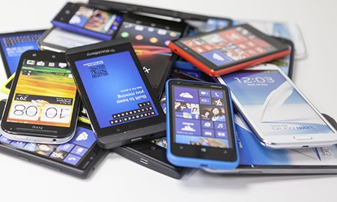
Method of Focal Objects
Synthesizing seemingly non-matching characteristics of different objects into something new
Combine existing objects to create something entirely new.
IT Examples:
Television Internet
Mobile phone Internet
Car Computer
Computer Mobile phone

Slide 17
Morphological Analysis
For an entire system:
Analyse outputs and interactions
Work backwards from outputs towards the system internals
Popular when you know very little about a system but you know the outputs/inputs.

Slide 18
Reduction
Transform a problem into another problem for which solutions exist
Example 1: At 9am, 10am, 11am and 12pm; what is the number of cars within car park #3 at the campus?
How would you do it?
We could quickly run around counting each car at each hour. But the car park is large, and cars are arriving and leaving.

Slide 19
Reduction…continued
We could have several people running around and counting (but similar problem).
We could take aerial photographs; and later count car images.
We could have people at each entry/exit counting cars that arrive and leave. (assume these people arrive early, say, when the car park is empty)

Slide 20
Reduction
Example 2: What is the sum of the following numbers?
1, 2, 3, 4, 5, 6, 7, 8
We could spend some time adding all of these numbers by hand or typing these into a computer: 1 + 2 + 3 + 4 + 5 + 6 + 7 + 8
= 36
What happens if you have 1 million numbers?

Slide 21
Root Cause Analysis (RCA)
Common with plane crash investigations or bugs in software
Eliminating the cause of the problem
Initially it’s a reactive method of problem detection and solving rather than in-depth analysis
This means that the analysis is done after an event has occurred. (car accident analysis)
By gaining expertise in RCA, it becomes a pro-active method.
This means that RCA is able to forecast the possibility of an event even before it could occur.

Slide 22
Root Cause Analysis (RCA)
IT Example: Problems that exist in software (bugs)
Normally bugs:
appear during or after development
are identified after they appear
Expert programmers:
can foresee many potential situations where bugs are likely to occur
pay more attention when coding such situations to eliminate future bugs

Slide 23
Trial-and-error
Test all possible solutions until the right one is found!
Slightly change a certain aspect and try again
Example:
finding an appropriate melody to new lyrics
tuning or bending a guitar string to obtain a pitch
developing medications

Slide 24

Thanks for reading, this little bit of reading will help to put you in the right mindset for week 1 and well prepared to tackle the next set of topics!

